Slide 1
Volunteer Management System
Presented by Team SE18-08S

Slide 2
Agenda
Project Revisit
Use Case Modeling
Software Architecture
Demo of Prototype
Transition Strategy
Project Progress
Challenges & Problems
Q & A

Slide 3
Project Revisit
Purpose: To build a web-based solution to facilitate the process of volunteer registration, project management till retention.
Requirement overview:
Volunteer Management
Staff Management
Project Management
Itinerary Management
Administration

Slide 4
Agenda
Project Revisit
Use Case Modeling
Software Architecture
Demo of Prototype
Transition Strategy
Project Progress
Development Plan
Challenges & Problems
Q & A

Slide 5
Use Case Modeling
Use Case Model Survey:
23 use cases
7 actors
Sample Use Cases:
Search Project Member
Assign Role to Project Member
Generate Certificate

Slide 6
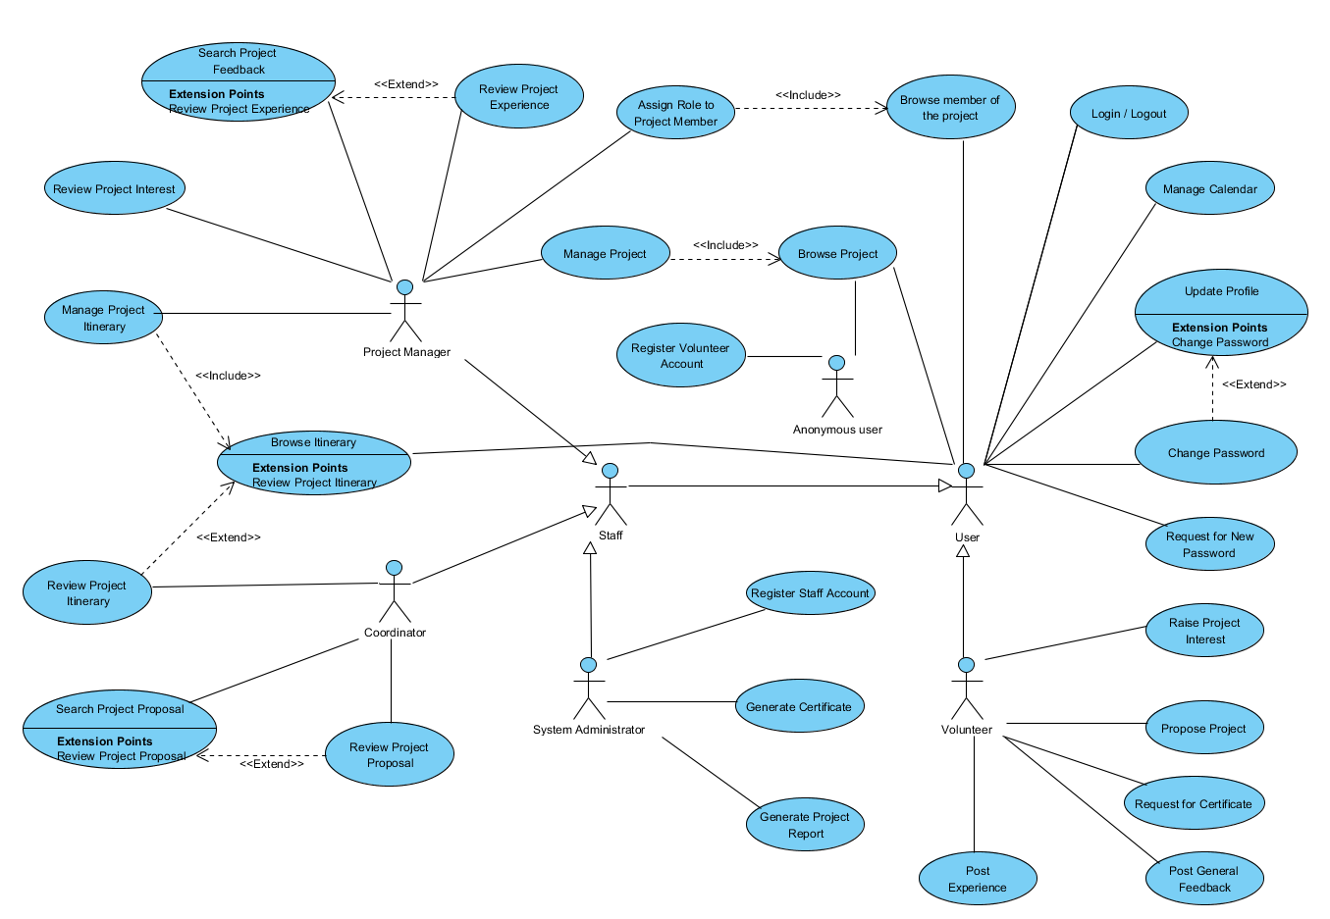

Slide 7
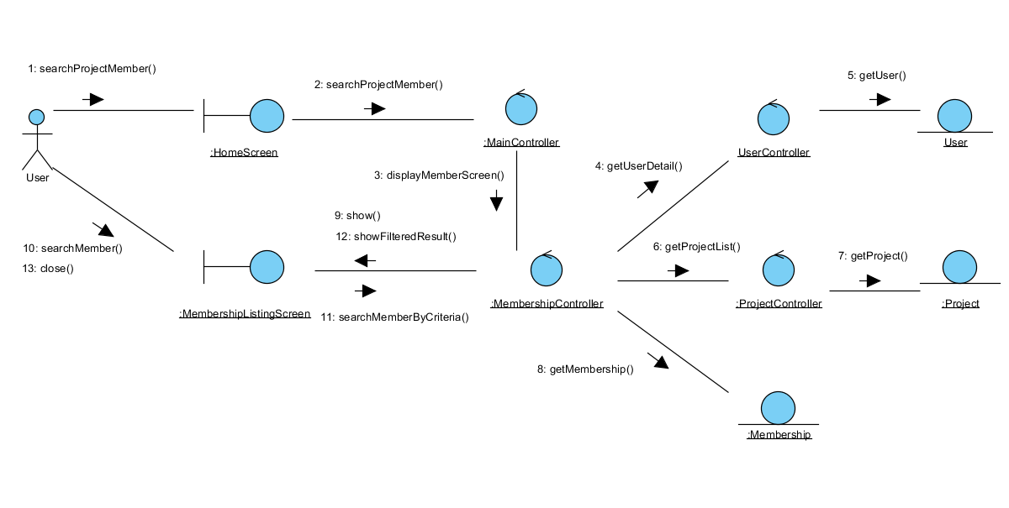
Use Case Modeling Sample 1: Search Project Member
Description: Let user search and view the member list of a project.
Interaction diagram

Slide 8
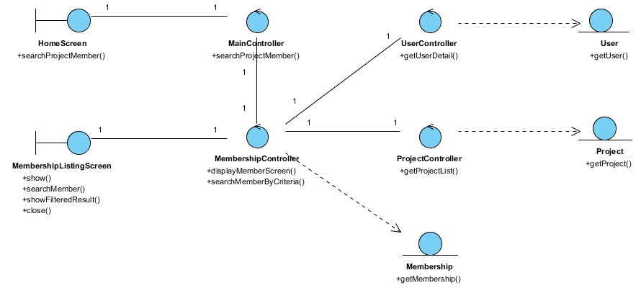
Use Case Modeling Sample 1: Search Project Member
Class diagram

Slide 9
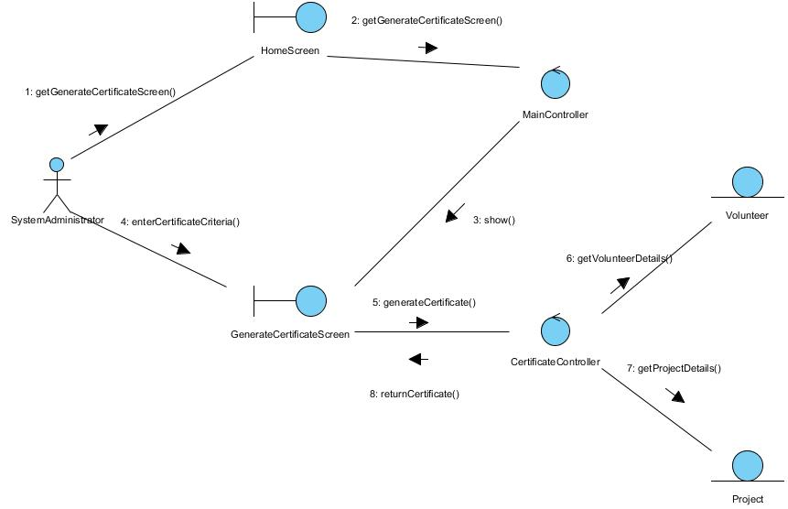
Use Case Modeling Sample 2: Generate Certificate
Description: Let user search and view the member list of a project.
Interaction diagram

Slide 10
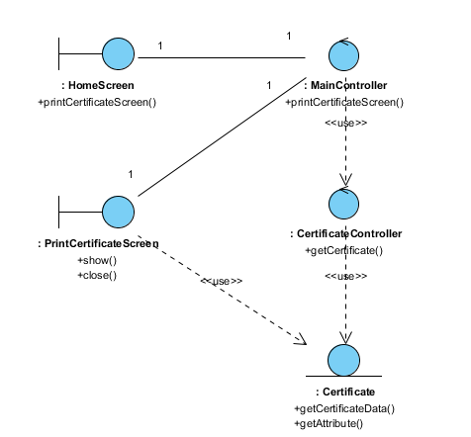
Use Case Modeling Sample 2: Generate Certificate
Class diagram

Slide 11
Agenda
Project Revisit
Use Case Modeling
Software Architecture
Demo of Prototype
Transition Strategy
Project Progress
Development Plan
Challenges & Problems
Q & A

Slide 12
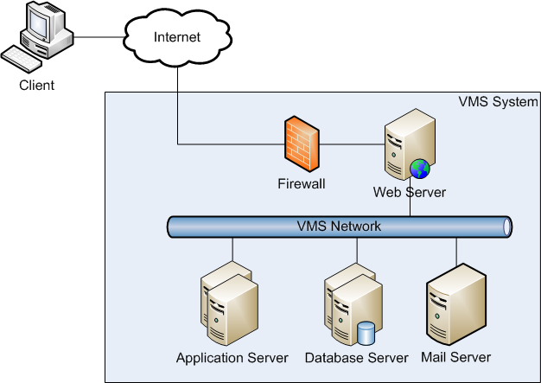
Software Architecture –Overview

Slide 13
Software Architecture –Architecture Overview
Web Server
Apache 2.2
Apache Load Balancer (JK module)
Application Server
Tomcat 6.0
Database Server (RDBMS)
MySQL 5
Mail Server
Any Java-supported mail server (eg. Gmail)

Slide 14
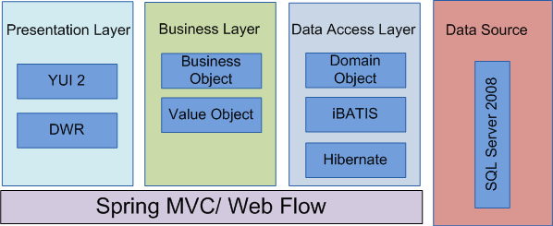
High Level Architecture – Framework Overview

Slide 15
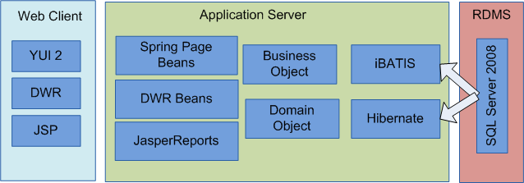
High Level Architecture – Overview of Components

Slide 16
Agenda
Project Revisit
Use Case Modeling
Software Architecture
Demo of Prototype
Transition Strategy
Project Progress
Development Plan
Challenges & Problems
Q & A

Slide 17
Demo of Prototype
Volunteer Management System

Slide 18
Demonstration of Prototype
Purpose of Technical Prototype:
Confirm system components working
Confirm feasibility and reusability
User Interface Prototype
Review usability
Confirm UI design with user

Slide 19
Agenda
Project Revisit
Use Case Modeling
Software Architecture
Demo of Prototype
Transition Strategy
Project Progress
Development Plan
Challenges & Problems
Q & A

Slide 20
Transition Strategy
Volunteer Management System

Slide 21
Transition Strategy – Analysis to Design
Project Planning
Analysis and Design
Prototyping
Use Case Modeling
Use Case Realisation Report
High-level System Design
Software Architecture
Transition Strategy from Analysis to Design
Project Management

Slide 22
Transition Strategy – Analysis to Design
No | Task | Description | In-Charge
1. | Prototyping | User interface prototyping Technical prototyping | Feng Yan, Jifa Zaw
2. | Use Case Modeling | Use case model survey | Thida, Hazel
3. | Use case realisation report | Use case realisation report | Thida, Hazel
4. | Software Design | High level software architecture design document | Zaw
5. | Transition Strategy from Analysis to Design | Transition Strategy from Analysis to Design | Zaw
6. | Project Management | Transition Strategy from Analysis to Design | Dio

Slide 23
Transition Strategy
Active member involvement
Involve all team members by clear and thorough communication
Clearly define roles and responsibilities
Assign tasks to staff by capability and experience
Active risk management
Anticipate risk early, accept and mitigate following the risk management techniques
Enforce tracking practices
Monthly progress update

Slide 24
Agenda
Project Revisit
Use Case Modeling
Software Architecture
Demo of Prototype
Transition Strategy
Project Progress
Development Plan
Challenges & Problems
Q & A

Slide 25
PROJECT Progress
Volunteer Management System

Slide 26
Project Progress
No | Activity | Planned Start Date | Planned End Date | Actual Start Date | Actual End Date | Planned Effort | Actual Effort | Task Status | Comments
1 | Project Planning
1.1 | Produce Project Plan | 21 Jan 2011 | 02 Apr 2011 | 20 Feb 2011 | 09 Apr 2011 | 7 | 9 | Done | Requirements gathering issues.
1.2 | Produce Quality Plan | 21 Jan 2011 | 02 Apr 2011 | 20 Feb 2011 | 05 Apr 2011 | 6 | 6.025 | Done | Makes changes based on Audit Meeting feedback
1.3 | Prepare First Audit & Presentation | 21 Jan 2011 | 02 Apr 2011 | 03 Apr 2011 | 09 Apr 2011 | 9 | 9 | Done
2 | Requirement Analysis
2.1 | Produce User Requirements Specifications | 22 Jan 2011 | 02 Apr 2011 | 20 Jan 2011 | 02 Apr 2011 | 18 | 13.6875 | Done
3 | Analysis Modelling
3.1 | Produce Functional Specifications : UCMS and UCRR (Analysis) | 10 Apr 2011 | 07 Jul 2011 |  |  | 38 |  | Open
3.3 | Produce Prototyping Study Report | 10 Apr 2011 | 12 Jun 2011 |  |  | 17.5 |  | Open

Slide 27
Agenda
Project Revisit
Use Case Modeling
Software Architecture
Demo of Prototype
Transition Strategy
Project Progress
Development Plan
Challenges & Problems
Q & A

Slide 28
DEVELOPMENT PLAN
Volunteer Management System

Slide 29
Development plan
No | Activity | Planned Start Date | Planned End Date | Actual Start Date | Actual End Date | Planned Effort | Actual Effort | Task Status | Comments
1 | Project Planning
1.1 | Produce Project Plan | 21 Jan 2011 | 02 Apr 2011 | 20 Feb 2011 | 09 Apr 2011 | 7 | 9 | Done | Requirements gathering issues.
1.2 | Produce Quality Plan | 21 Jan 2011 | 02 Apr 2011 | 20 Feb 2011 | 05 Apr 2011 | 6 | 6.025 | Done | Makes changes based on Audit Meeting feedback
1.3 | Prepare First Audit & Presentation | 21 Jan 2011 | 02 Apr 2011 | 03 Apr 2011 | 09 Apr 2011 | 9 | 9 | Done
2 | Requirement Analysis
2.1 | Produce User Requirements Specifications | 22 Jan 2011 | 02 Apr 2011 | 20 Jan 2011 | 02 Apr 2011 | 18 | 13.6875 | Done
3 | Analysis Modelling
3.1 | Produce Functional Specifications : UCMS and UCRR (Analysis) | 10 Apr 2011 | 07 Jul 2011 |  |  | 38 |  | Open
3.3 | Produce Prototyping Study Report | 10 Apr 2011 | 12 Jun 2011 |  |  | 17.5 |  | Open

Slide 30
Agenda
Project Revisit
Use Case Modeling
Software Architecture
Demo of Prototype
Transition Strategy
Project Progress
Development Plan
Challenges & Problems
Q & A

Slide 31
Challenges & Problems
Volunteer Management System

Slide 32
Challenges & Problems
No | Challenge | Description | Solution
1. | Communications | Difficulty to gather all members for discussions. | Online meeting via Skype To fix a weekly meeting time
2. | Requirements Gathering | Client only wants a small set of requirements. | Seek lecturers advice Proposed merging of requirements Appoint team members as putative end users Look for alternative customer
3. | Task Control | Not able to meet deadline on time. | To log time log To hold meetings to track status
4. | Low Quality of Work | Deliverables not up to standard. | Perform reviews Conduct briefing and demo on required items

Slide 33
Agenda
Project Revisit
Use Case Modeling
Software Architecture
Demo of Prototype
Transition Strategy
Project Progress
Challenges & Problems
Q & A

Slide 34
Question & Answer

